Slide 1
Name : prithviraj ashok desai email: desaiprithviraj153@gmail.com task :Instagram user analytics
Analysis done on the following points:-
Part (A). Marketing :-
Rewarding Most Loyal Users
Remind Inactive Users to Start Posting
Declaring the contest winners
Hashtag Researching
Launch AD Campaign
Part (B). Investor Metrics :-
User Engagement
Bots and Fake Accounts
SOFTWARE USED :MYSQL WORKBENCH 8.0 CE

Slide 2
(A) Marketing
Rewarding Most Loyal Users :
People who have been using the platform for the longest time.(Top 5 oldest Instagram users)
To identify the most loyal users, i.e., the top 5 oldest users of Instagram, we'll utilize the data from the users table.
This involves selecting the username and created_at columns.
Employing the order by function, we'll arrange the output by sorting with the created_at column in ascending order, ensuring the earliest registrations appear first.
Lastly, we'll use the limit function to display the top 5 oldest Instagram users, providing a concise and focused result.
QUERY:
SELECT *
FROM users
ORDER BY created_at ASC
LIMIT 5;

Slide 3
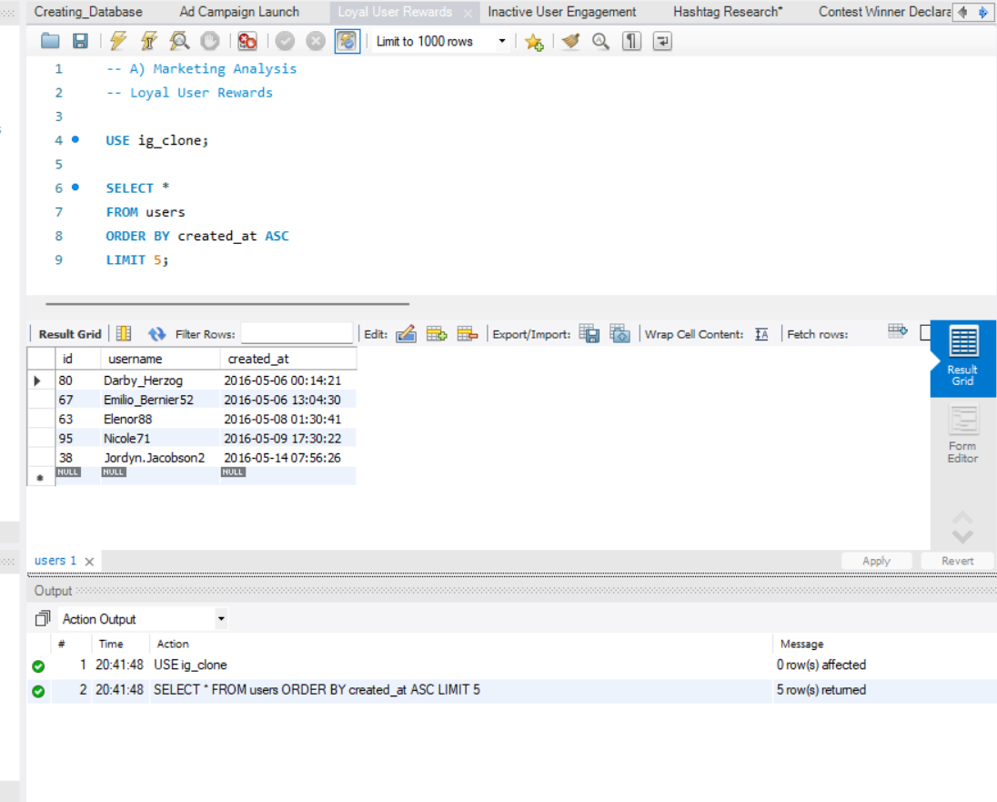
Marketing
Rewarding Most Loyal Users
OUTPUT:
Top 5 oldest Instagram users
username | created_at
Darby_Herzog | 06-05-2016 00:14
Emilio_Bernier52 | 06-05-2016 13:04
Elenor88 | 08-05-2016 01:30
Nicole71 | 09-05-2016 17:30
Jordyn.Jacobson2 | 14-05-2016 07:56

Slide 4
(A) Marketing
Inactive User Engagement:
Identify users who have never posted a single photo on Instagram
To Find the most inactive users i.e. the users who have never posted a single photo on Instagram:
The outer query selects all columns (*) from the 'users' table.
The subquery, enclosed in parentheses, selects distinct 'user_id' values from the 'photos' table. These are the users who have posted photos.
The WHERE clause filters the users based on their 'id', excluding those whose 'id' is not found in the set of distinct 'user_id' values from the 'photos' table.
QUERY:
SELECT *
FROM users
WHERE id NOT IN (
SELECT DISTINCT user_id FROM photos)

Slide 5
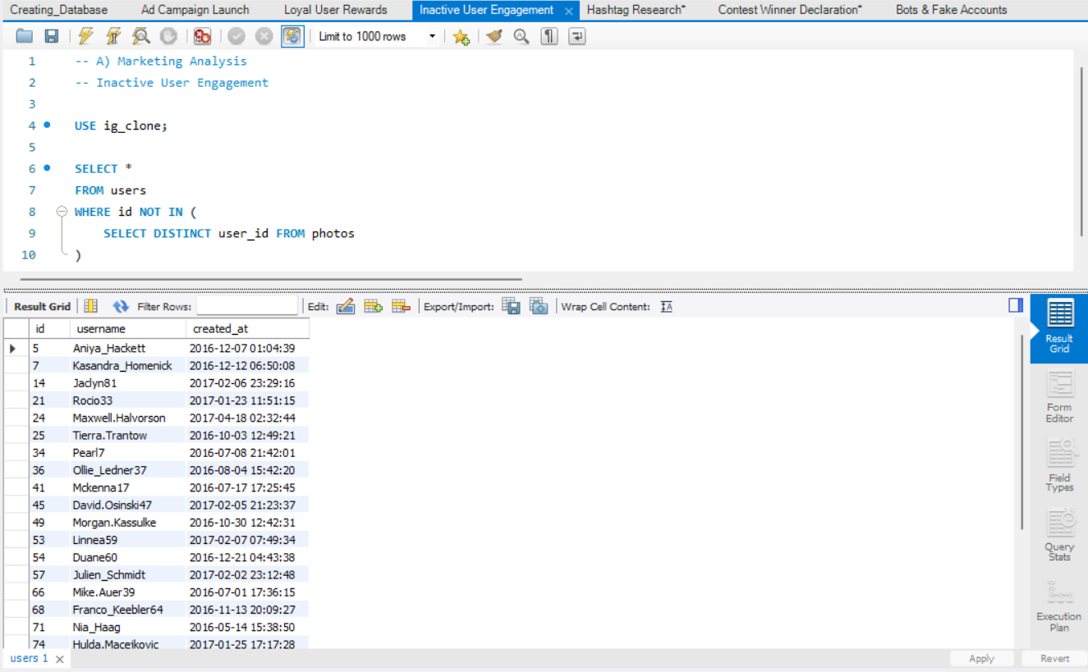
Marketing
Inactive User Engagement
OUTPUT:
users who have never posted a single photo on Instagram
ID | USERNAME
5 | Aniya_Hackett
7 | Kasandra_Homenick
14 | Jaclyn81
21 | Rocio33
24 | Maxwell.Halvorson
25 | Tierra.Trantow
34 | Pearl7
36 | Ollie_Ledner37
41 | Mckenna17
45 | David.Osinski47

Slide 6
Marketing
Inactive User Engagement
ID | USERNAME
49 | Morgan.Kassulke
53 | Linnea59
54 | Duane60
57 | Julien_Schmidt
66 | Mike.Auer39
68 | Franco_Keebler64
71 | Nia_Haag
74 | Hulda.Macejkovic
75 | Leslie67
76 | Janelle.Nikolaus81
80 | Darby_Herzog
81 | Esther.Zulauf61
83 | Bartholome.Bernhard
89 | Jessyca_West
90 | Esmeralda.Mraz57
91 | Bethany20
There are in total 26 users of the 100 users who have never posted a single photo on Instagram

Slide 7
(A) Marketing
Declaring the contest winners:
The team has organized a contest where the user with the most likes on a single photo wins. Identify the winner of the contest and provide their details to the team.
First we select the users.username, photos.id, photos.image_url, and COUNT(*) as total.
The tables 'photos', 'likes', and 'users' are inner joined based on the conditions likes.photo_id = photos.id and photos.user_id = users.id.
The GROUP BY function is applied to group the output based on the 'photos.id'. This allows counting the total number of likes for each photo.
The ORDER BY function is used to sort the data in descending order based on the 'total'. This ensures that the photo with the highest number of likes appears first.
QUERY:
select users.id as user_id, users.username, photos.id as photo_id,
photos.image_url, count(*) as total
from photos
inner join likes on likes.photo_id = photos.id
inner join users on photos.user_id = users.id
group by photos.id order by total DESC
limit 1;

Slide 8
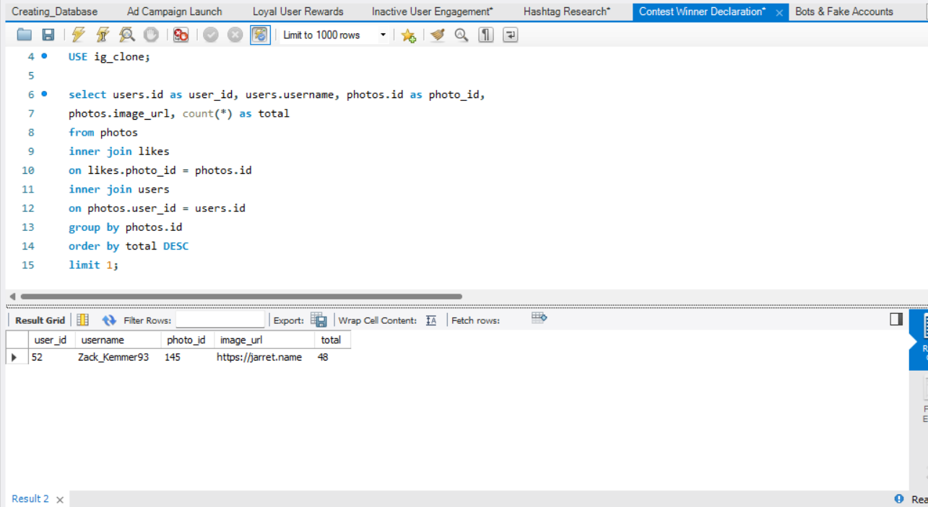
(A)Marketing
Declaring the contest winners
OUTPUT:
The user named Zack_Kemmer93 with user_id 52 is the winner of the contest cause his photo with photo_id 145 has the highest number of likes i.e. 48
ID | USERNAME | PHOTO_ID | IMAGE_ID | TOTAL
52 | Zack_Kemmer93 | 145 | https://jarret.name | 48

Slide 9
(A)Marketing
Hashtag Researching:
A partner brand wants to know the most popular hashtags to use in their posts to reach the most people .Identify and suggest the top five most commonly used hashtags on the platform.
The CTE named cte_query is created to calculate the count of tag usage (times_used) and apply dense ranking to the tags based on the count in descending order.
The main query selects the ranked position as Top_5, tag_name, and times_used from the CTE.
The WHERE clause filters the results to include only the top 5 ranked tags.
The LIMIT 5 ensures that the result includes only the top 5 tags.
QUERY :
WITH cte_query AS
(SELECT t.id, tag_name, COUNT(t.id) AS times_used, DENSE_RANK() OVER(ORDER BY COUNT(t.id) DESC) AS ranked
FROM tags t
LEFT JOIN photo_tags pt ON t.id = pt.tag_id
GROUP BY t.id
ORDER BY times_used DESC
)
SELECT ranked AS Top_5, tag_name, times_used
FROM cte_query
WHERE ranked <= 5
LIMIT 5;

Slide 10
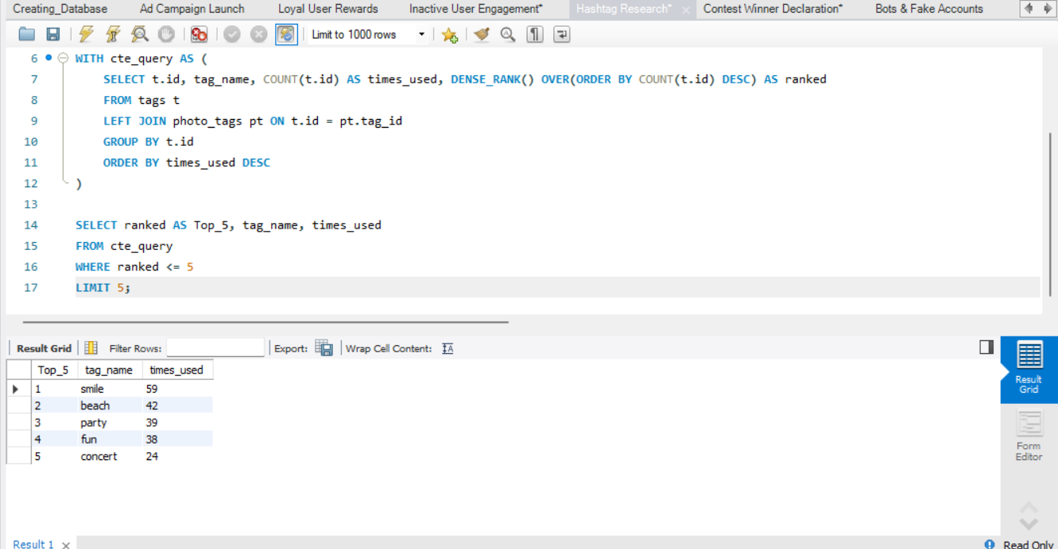
(A)Marketing
Hashtag Researching
OUTPUT:
Top 5 commonly used
#Hashtags on Instagram
TAG_NAME | TIME_USED
smile | 59
beach | 42
party | 39
fun | 38
concert | 24

Slide 11
(A)Marketing
Launch AD Campaign:
The team wants to know, which day would be the best day to launch ADs.
(What day of the week do most users register on?)
The SELECT statement retrieves the day of the week using DAYNAME(created_at) and counts the number of users registered on each day.
The GROUP BY clause groups the results based on the day of the week, creating distinct groups for each day.
The COUNT(*) function calculates the number of users registered in each group (day of the week).
The ORDER BY clause sorts the results in descending order based on the number of users registered on each day.
QUERY:
SELECT DAYNAME(created_at) AS day_of_week, COUNT(*) AS users_registered
FROM users
GROUP BY day_of_week
ORDER BY users_registered DESC;

Slide 12
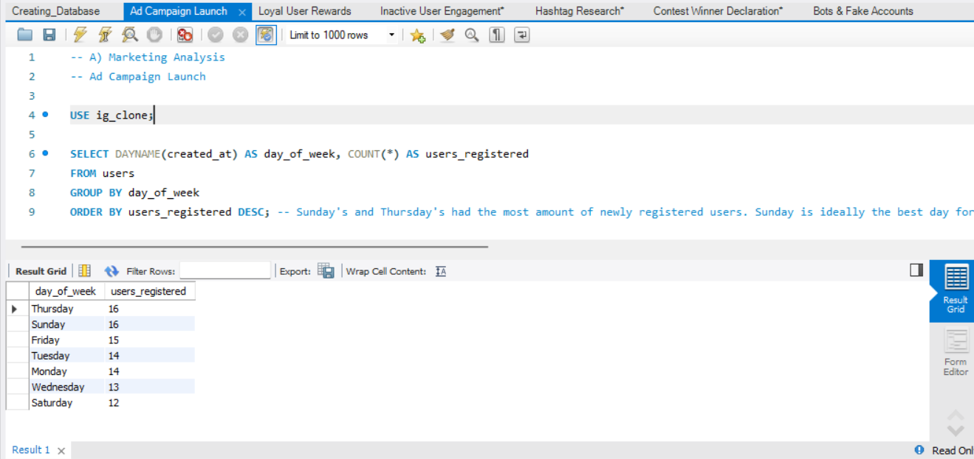
(A)Marketing
Launch AD Campaign
OUTPUT:
DAY_OF_WEEK | USERS_REGISTERED
Thursday | 16
Sunday | 16
Friday | 15
Tuesday | 14
Monday | 14
Wednesday | 13
Saturday | 12
Sunday's and Thursday's had the most amount of newly registered users.
Sunday is ideally the best day to launch a ad campaign

Slide 13
(B)Investor Metrics
User Engagement:
Are users still as active and post on Instagram or they are making fewer posts.
Find how many times does average user posts on Instagram?
Also, provide the total number of photos on Instagram/total number of users
The CTE named cte_query is created to calculate the count of photos posted by each user (posted), grouping by user ID.
Average_post_per_user: The average number of posts per user, rounded to 2 decimal places.
Total_photos: The total number of photos across all users.
Total_users: The total number of distinct users.
Photos_per_user: The average number of photos per user.
QUERY:
WITH cte_query AS (
SELECT u.id, username, COUNT(p.id) AS posted
FROM users u
LEFT JOIN photos p ON p.user_id = u.id
GROUP BY u.id
ORDER BY u.id ASC
)
SELECT ROUND(AVG(posted), 2) AS average_post_per_user, SUM(posted) AS total_photos,
COUNT(DISTINCT id) AS total_users, SUM(posted) / COUNT(DISTINCT id) AS photos_per_user
FROM cte_query

Slide 14
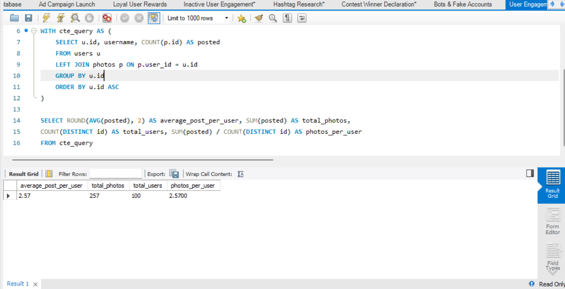
(B)Investor Metrics
User Engagement
OUTPUT:
So, there are in total 257 rows i.e.
257 photos in the photos table and
100 rows i.e. 100 ids in the users table
which makes the desired output to be
257/100 = 2.57
AVERAGE_POST_PER_USER | TOTAL_PHOTOS | TOTAL_USERS | PHOTOS_PER_USER
2.57 | 257 | 100 | 2.5700

Slide 15
(B)Investor Metrics
Bots and Fake Accounts :
The investors want to know if the platform is crowded with fake and dummy accounts. Provide data on users (bots) who have liked every single photo on the site (since any normal user would not be able to do this).
Initially, the user_id column is selected from the photos table.
Following that, the username column is chosen from the users table.
Subsequently, the count(*) function is applied to calculate the total number of likes from the likes table.
An inner join is performed between the users and likes tables based on the users.id and likes.user_id, utilizing the on function/clause.
The desired output table is then grouped based on the likes.user_id using the group by function.
The values obtained from the count(*) function for photos are searched, specifically looking for those with equal values to the total_likes_per_user.
QUERY:
SELECT user_id, username, count(*) as total_likes_per_user from users inner join likes
on users.id = likes.user_id
GROUP BY likes.user_id
having total_likes_per_user = (select count(*) from photos);

Slide 16
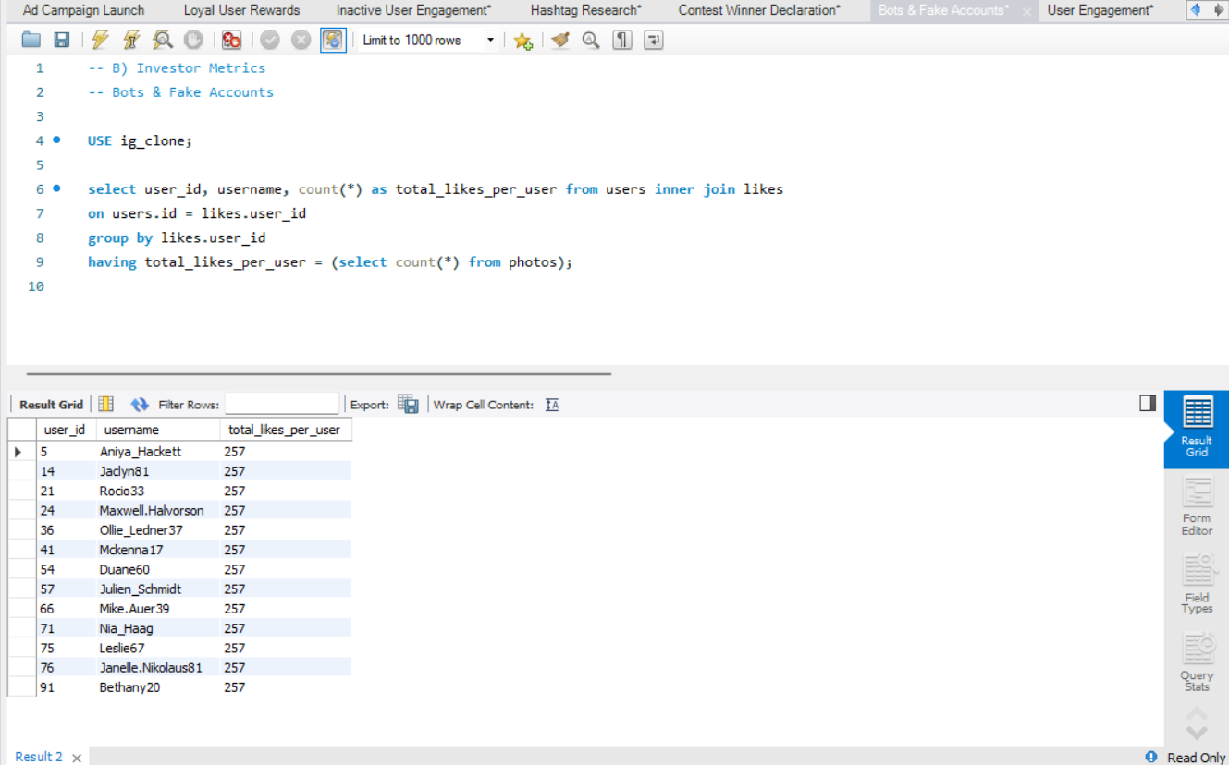
(B)Investor Metrics
Bots and Fake Accounts
OUTPUT:
ID | USERNAME | TOTAL_LIKES_PER_USER
5 | Aniya_Hackett | 257
14 | Jaclyn81 | 257
21 | Rocio33 | 257
24 | Maxwell.Halvorson | 257
36 | Ollie_Ledner37 | 257
41 | Mckenna17 | 257
54 | Duane60 | 257
57 | Julien_Schmidt | 257
66 | Mike.Auer39 | 257
71 | Nia_Haag | 257
75 | Leslie67 | 257
76 | Janelle.Nikolaus81 | 257
91 | Bethany20 | 257
This user_ids are high likely to be bots or fake accounts
since each user has liked every single photo on the site (since any normal user would not be able to do this).

